Slide 1
CIS 581 Project Face Swapping between Videos
Team Number : 5
Team Members : Caren Jerome, Sharanya Venkat, Neha Dohare, Malathy Nagalakshmi, Pooja Dattatri, Revathi Vijayaraghavan

Slide 2
Objective
Face swapping refers to the task of transferring the source face to the target while maintaining the target’s expressions and environmental context.
Through this project, we implement an efficient framework for face swapping in videos.

Slide 3
Overview of Algorithm
Replacement Video Selection
Facial Landmark Detection
Stabilisation of Facial Landmarks
Feature Extraction
Face Swapping
For the given dataset of source videos, select appropriate target videos to perform face swapping with.
Accurately detect faces within a given frame of the video and further proceed to identify the facial landmarks within the detected face.
Facial landmark points are precisely extracted from the face images to allow for efficient swapping of faces while maintaining realism.
Due to continuous motion of pixels in videos, the translational and rotational variances may cause facial landmarks to be unstable.
Few of the points can go missing from the features of the face giving rise to problems in feature estimation, and thus affecting the efficiency of the model and the results.
Using the landmarks previously obtained, a convex hull is created that will further serve as indices for both the frames in consideration for swapping.
A Delaunay Triangulation is then generated for the convex hull.
Do affine transformation triangle to triangle.
Perform seamless blending.

Slide 4
Ad hoc Solutions to Edge Cases
We handle the challenges related to
Preservation of emotions.
Varying exposure, lighting and shadows - using CLAHE (Contrast limited Adaptive Histogram Equalization)
Keeping track of the difference in the number of frames of the two videos - the last frame from the shorter video will be utilised to populate the frames until the last frame from the longer video is reached.
We achieve a good level of video-realism on a variety of human faces with different identities, ethnicities, skin colors, and expressions.

Slide 5
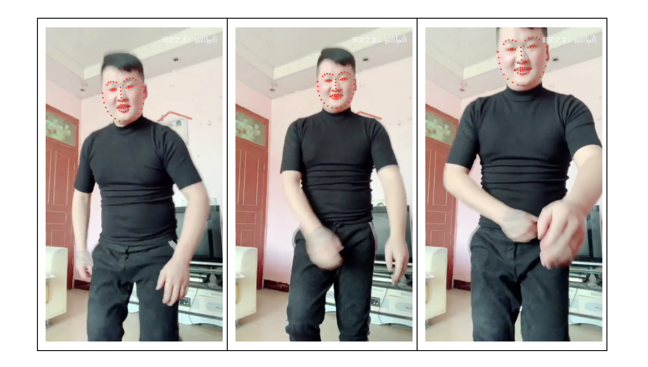
Results
Facial Landmark Detection and stabilization
Dlib package 68 point landmark detector is a frontal face detector used to initially obtain the faces in an image. This is followed by a pre-trained predictor model, that will extract the facial landmarks within the detected face localizing the region around the eyes, eyebrows, nose, mouth, chin and jaw to identify 68 points.

Slide 6
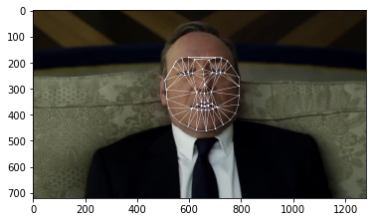
Results
Delaunay Triangulation on source
Why do we divide the face into triangles?
We can’t just cut out the face from the source image and put it into the destination image as they have different size and perspective.
Also we can’t change its size and perspective right away because the face would lose the original proportions. Instead if we split the face into triangles, we can simply swap each triangle and in this way it will keep the proportions and also it will match the expressions of the new face, like for example if you smile, close eyes or open the mouth.

Slide 7
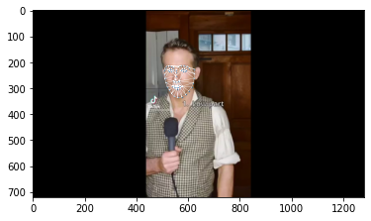
Results
Delaunay Triangulation on target
The triangulation of the destination image needs to have the same patterns of the triangulation of the source image.
That means that the connection of the points has to be the same.
So after we do the triangulation of the source image, from that triangulation we take the indexes of the landmark points so that we can replicate the same triangulation on the destination image.

Slide 8
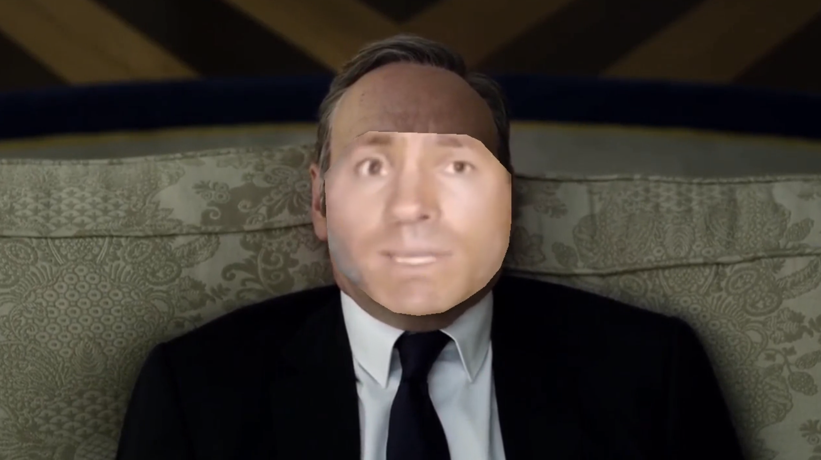
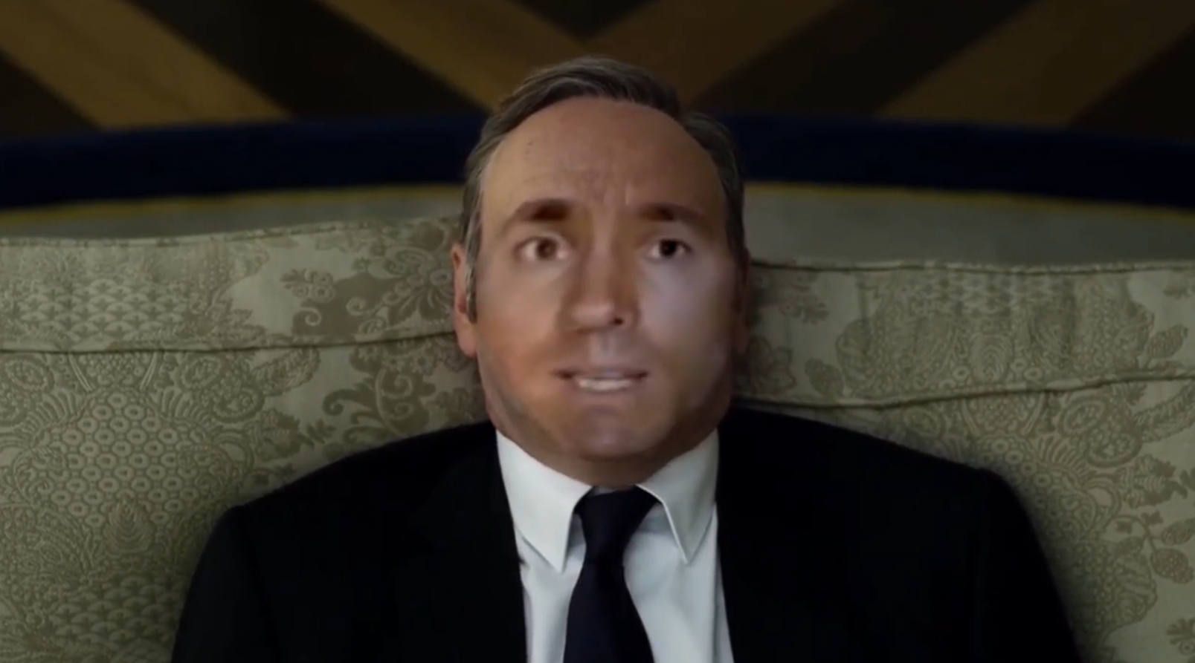
Results
Comparison of Results without and with Seamless Blending

Slide 9
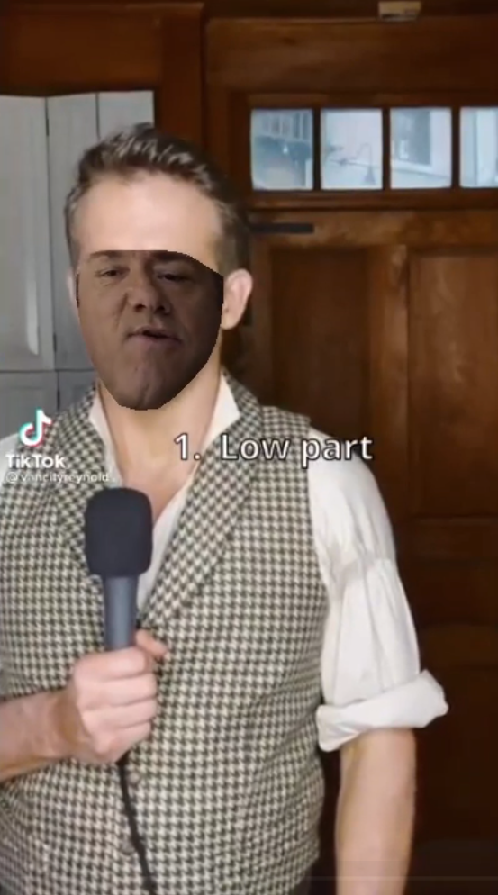
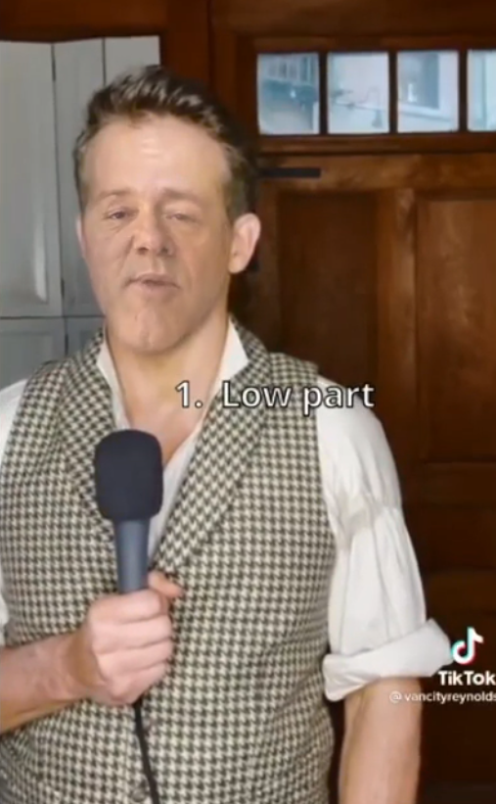
Results
Comparison of Results without and with Seamless Blending

Slide 10
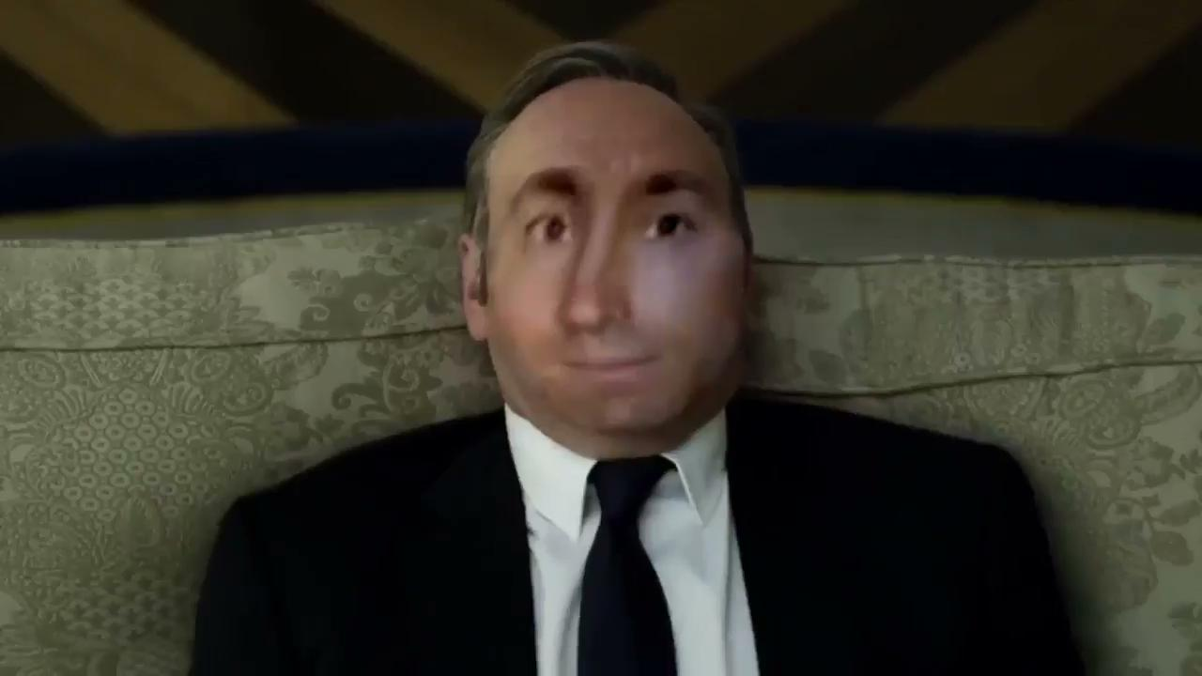
Result

Slide 11

Result

Slide 12
Extra Credit
We also successfully performed Face Swapping within a single video
The basic flow of the algorithm remains the same as discussed before.
We run the facial landmark detection algorithm, and if two faces are detected in a single frame, we know we have to swap two faces in the same video.
Although the entire procedure remains the same, there were modifications to be made in the triangulation and blending steps such that one single frame with the swapped faces was returned.
Notes:
swapping faces in same frame had multiple cases to be handled - every step from stabilization onwards had to be modified to run for more than one faces.
Triangulation - affine transform - initially returns face from source pasted on target. Since source and target here are the same, this was to be handled. Earlier triangulation was being done on the source (in one iteration) and target in the next (frames are independent of each other), which needed to be done for both the source and target now. (outputs were independent of each other)
Simply calling triangulation twice and merging the frames does not give satisfactory results, as this was causing issues with blending.

Slide 13

Source Video

Slide 14
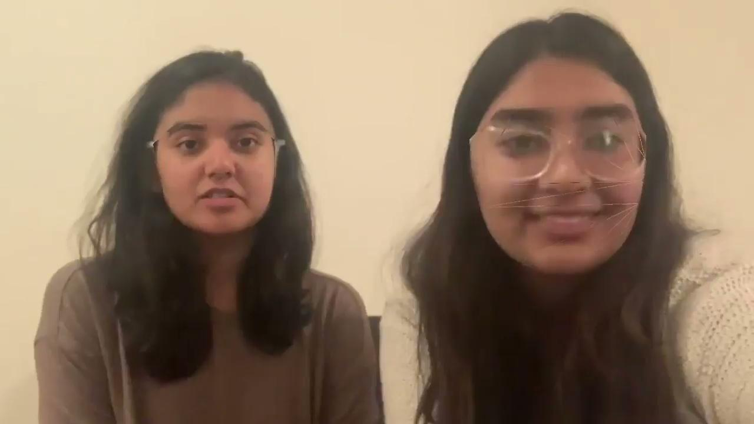
Result

Slide 15
Limitations
System produces poor results when full frontal face is not visible for extended periods of time.
Cannot handle swapping of multiple faces between two or more videos

Slide 16
Future Work
For videos in which faces move out of view, we could track features more robustly using history of frames
We could also try swapping multiple faces in videos, and handle cases like unequal number of faces between source and target videos

Slide 17
Thank you

